Slide 1
Dr. Suha K. Shihab
Compression Testing
These tests are used mainly in connection with cast iron and concrete, since these are materials more likely to be used under the action of compressive forces than in tension. A cylindrical block, the length of which is twice its diameter, is used as a test-piece as shown in Figure 1 (A). This is compressed (using a tensile-testing machine running in ‘ reverse ’ ) until it fails.
Malleable metals do not show a well-defined point of failure as in Figure 1(B), but with brittle materials Figure 1 (C), the ultimate compressive stress can be measured accurately, since the material fails suddenly, usually by multiple shear at angles of 45 ° to the direction of compression.
Figure 1 T he behaviour of brittle and ductile materials during a compression test.

Slide 2
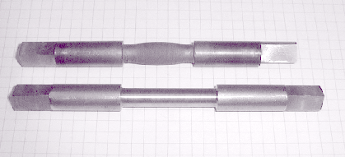
Dr. Suha K. Shihab
For brittle materials, the compressive strength is relatively easy to obtain, showing marked failure. However, for ductile materials, the compressive strength is generally based on an arbitrary deformation value. Ductile materials do not exhibit the sudden fractures that brittle materials present. They tend to buckle and "barrel out“ (Figure2).
Many operations in manufacturing, particularly processes such as forging, rolling, and extrusion , are performed with the workpiece subjected to compressive stresses. The compression test, in which the specimen is subjected to a compressive load, gives information that is useful for estimating forces and power requirements in these processes.
Figure 2 Bulging of a Sample under Compressive Loads

Slide 3
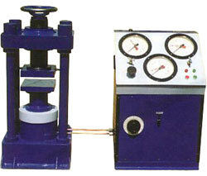
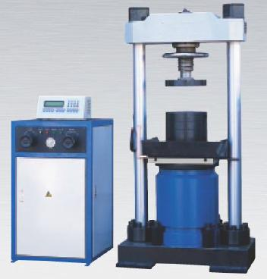
Dr. Suha K. Shihab
Compression Testing Machines

Slide 4
Dr. Suha K. Shihab
It has been observed that some errors always creep in the compressive test due to the following practical difficulties:

Slide 5
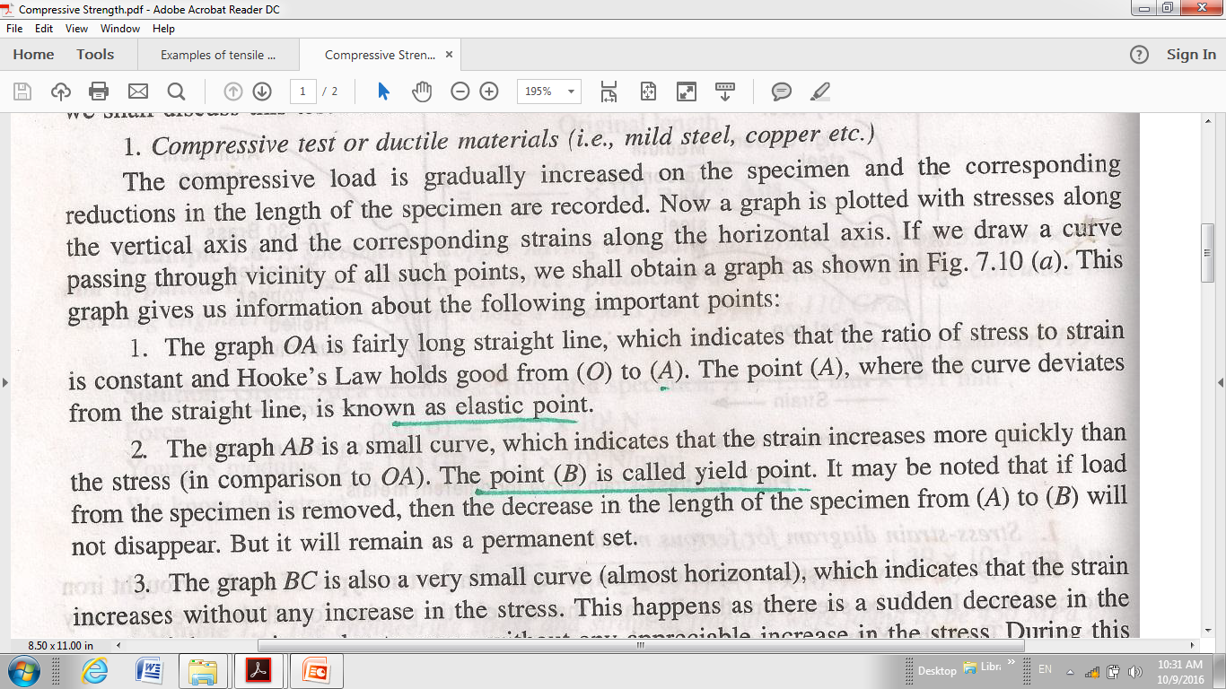
Dr. Suha K. Shihab

Slide 6
Dr. Suha K. Shihab

Slide 7
Dr. Suha K. Shihab

